Slide 1
Cognition Fundamentals: Refresher
Cognitive Models of Language Learning & Large Language Models
Responsible Lecturer: Bram Heijligers

Slide 2
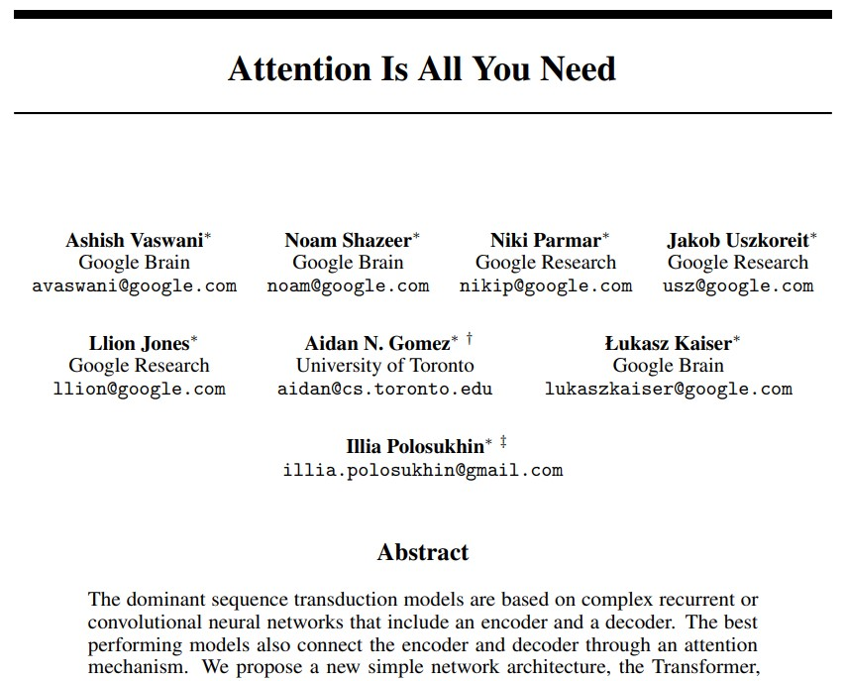
Going full-circle...

Slide 3
Table of Contents
Recap of:
Book chapter 1 - 5
---- SHORT BREAK ----
Large Language Models & Cognition
Recurrent Neural Networks
Transformers
How they connect
Afternoon:
Use-case 2 walkthrough
Feedback & Q&A

Slide 4
How do we learn language?
How do we acquire meaning?

Slide 5
What is Modeling of Language Learning?
Human language learning
Identify processes and mechanisms involved in learning language
Detect common behavioural patterns among children
(Computational) modeling
Simulate a cognitive process via computational tools and techniques
Use the model to explain the observed human behaviour
Modeling of language learning
Develop computational simulations of the process of human language acquisition

Slide 6
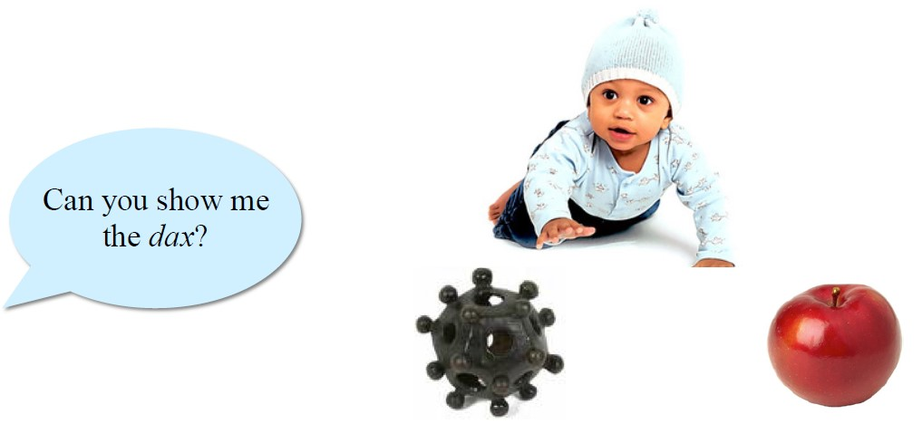
Word Meaning
Young children easily map novel words to novel objects in
familiar context
However, mapping words alone is not enough...

Slide 7
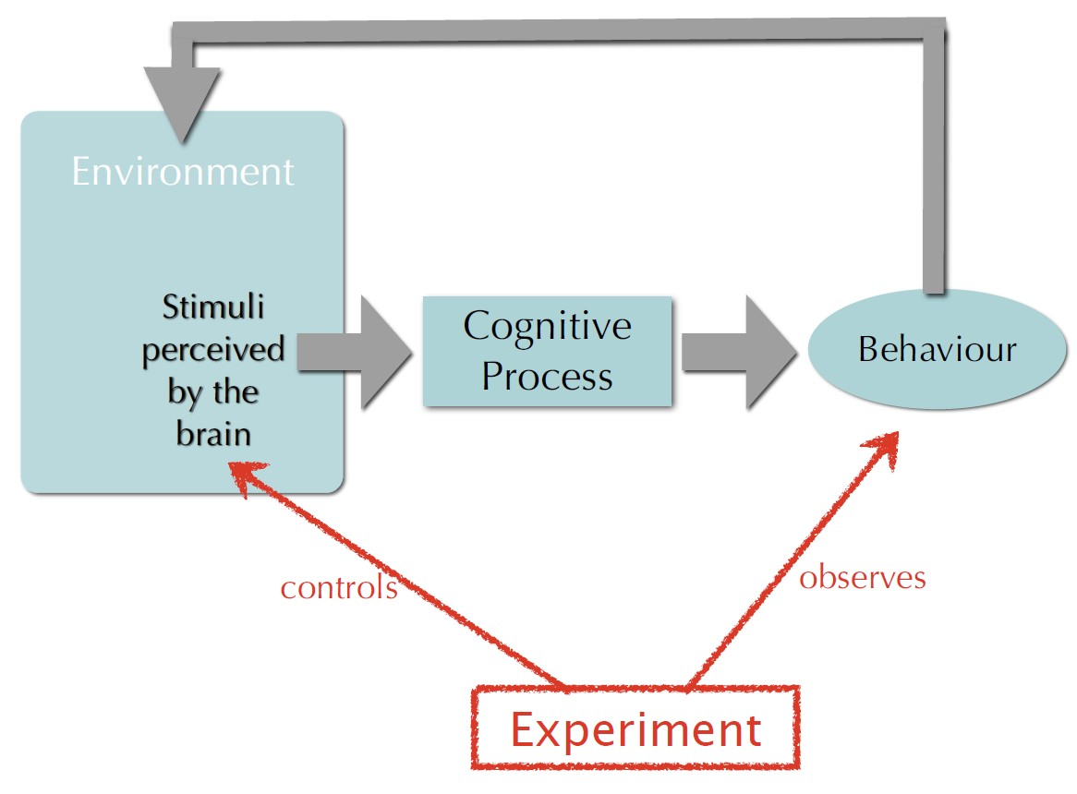
How do we learn the meaning of a word?
More complex... That’s were science comes in...

Slide 8
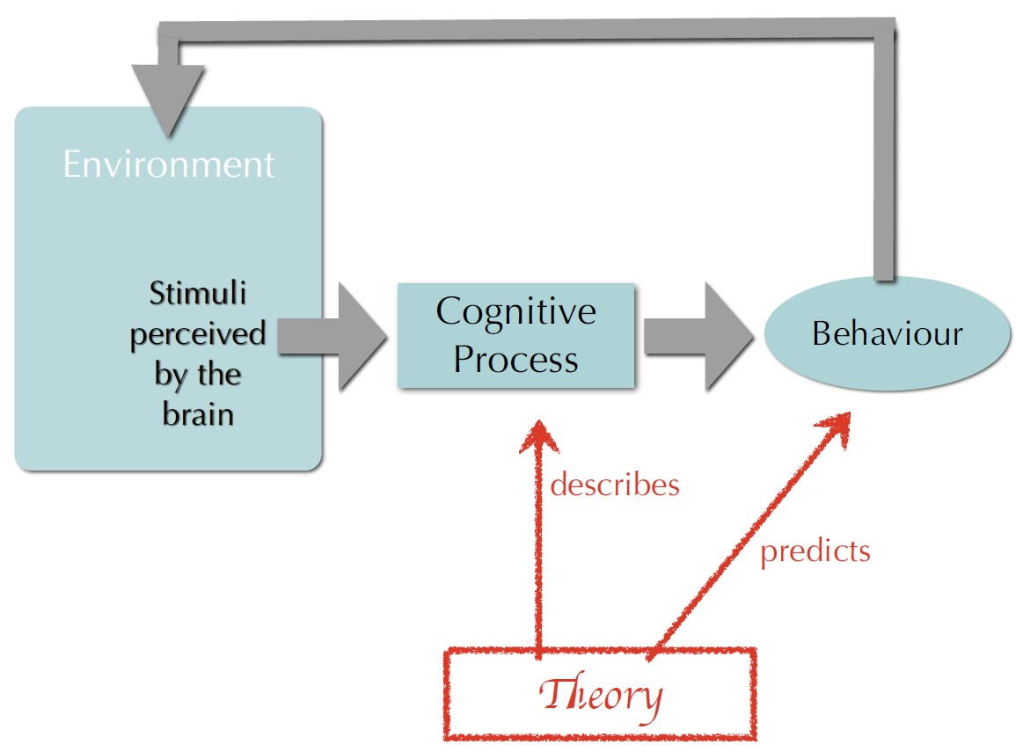
How do we learn the meaning of a word?
More complex... That’s were science comes in...

Slide 9
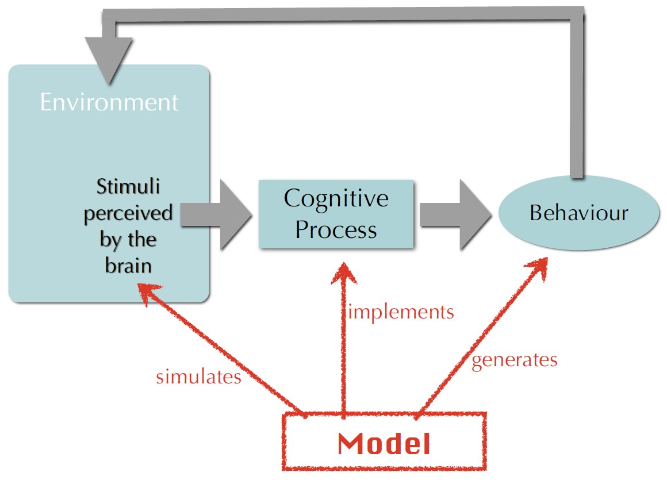
How do we learn the meaning of a word?
More complex... That’s were science comes in...

Slide 10
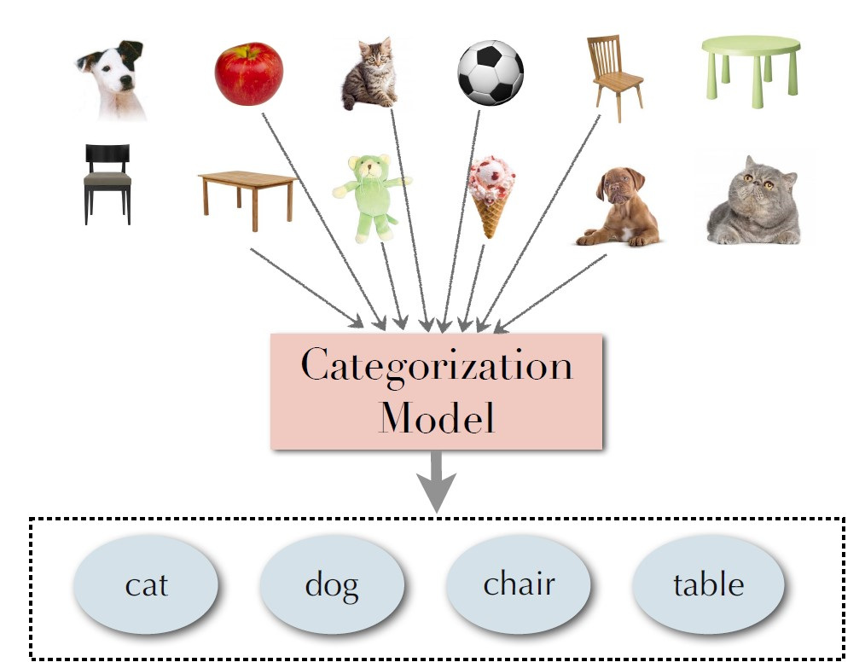
Assigning Meaning to a word
It all start with categories:
We all like to put things in boxes
It’s the most basic component to assign meaning

Slide 11
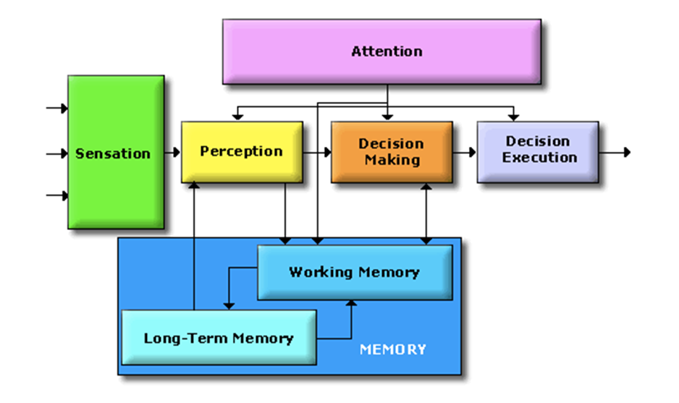
The Cognitive System
Cognitive scientists study intelligence and behavior, with a focus on how the nervous systems represent, processes, transforms, stores and recoverers information.
Essentially, information is captured by ‘sensors’
from where it is processed and in different ways:
Like data flowing through an
algorithm!
Key difference is the human minds
limited processing capacity which is
why we need attention! → Selection!
Not actually separate parts; nothing is truely separate, but
classification is how humans deal with information → r.i.p. us
Notes:
On the separate parts:
This approach is taken to aid clarity of explanation, but in so doing, can give the impression that individual aspects of cognition can be understood in isolation from each other. However, it is always important to remember that to properly understand the role of any single aspect of cognition we must appreciate how that role is dependent upon and interacts with other aspects.

Slide 12
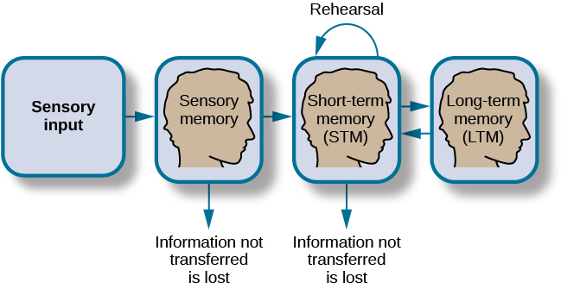
How memory functions

Slide 13
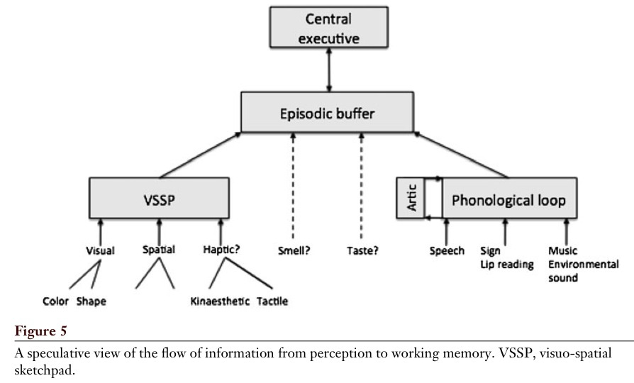
Working Memory for Perception
Baddeley, 2012

Slide 14
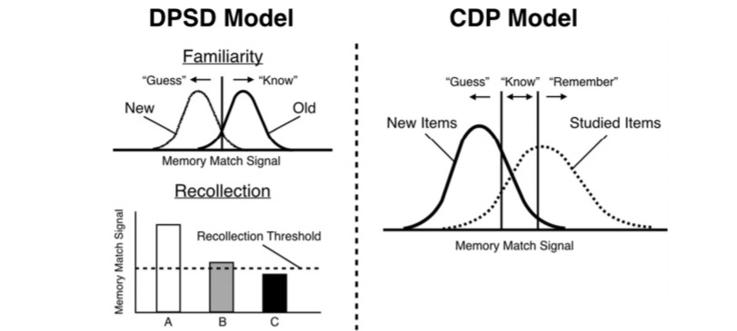
Familiarity vs. Recollection: The DPSD and CDP Models
Notes:
DPSD = dual-process signal-detection
The dual-process signal-detection (DPSD) model assumes that recognition memory is based on recollection of qualitative information or on a signal-detection-based familiarity process.
CDP = continuous dual process
The dual-process theory of recognition memory holds that recognition ‘decisions’ can be based on either recollection or familiarity, and the gues/know/remember procedure is seen as continuous flow and see recollection as a stronger form of familiarity.
What’s important to remember is that the signals stored in the long-term memory is compared to that in the working-memory.

Slide 15
Active Sampling - (Learning)
A type of cognitive strategy in which a person actively engages with their environment in order to acquire new knowledge or information. Can include:
intentional exploration of unfamiliar surroundings;
taking part in activities that provide new experiences;
and actively seeking out new sources of information
Active sampling is seen as a more efficient way for people to learn and acquire new knowledge as it involves actively engaging with the environment rather than passively absorbing information.

Slide 16
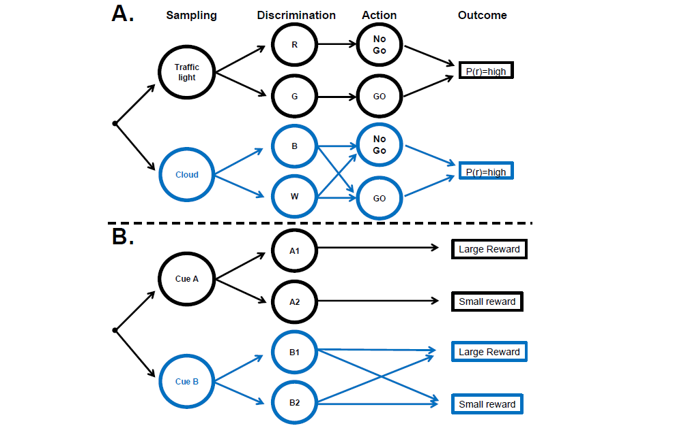
Decision chains for sampling and action
Gottlieb, 2018

Slide 17
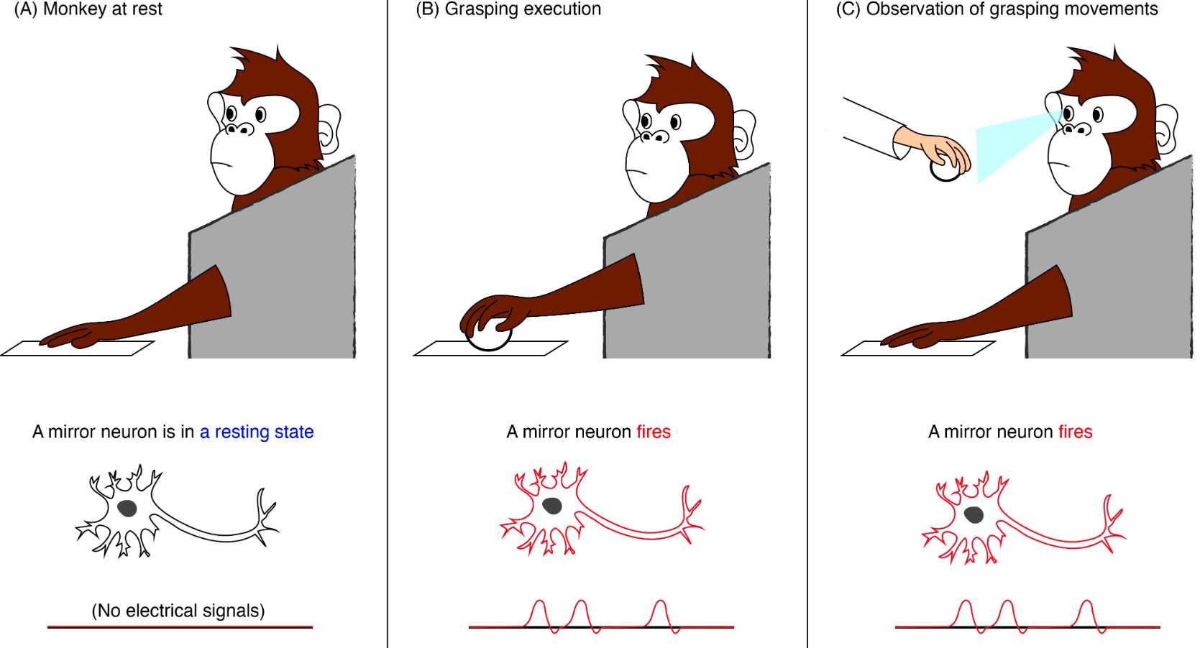
Mirror-Neurons – (learning)

Slide 18
Questions?
Let’s start working on use-case 1!

Slide 19
Break
Take a walk of 5 minutes and meet me at the Innovation Square!
Be back in 20 minutes for the perception lecture!

Slide 20
How do neural networks and cognition relate?
How does research into cognitive science drive developments in Artificial Intelligence?

Slide 21


